Slide 1

Classes in Java

Slide 2
CLASS AS A DATA TYPE

Slide 3
Data Type
A data type is a set of values and a set of operators that operate on those values.
For example, the integer (primitive data) type:
Set of integer values
Set of operators: +, -, *, /, etc.

Slide 4
Abstract Data Type
An abstract data type (“programmer-defined type”) is a new data type constructed from the primitive data types.
For example, an XYCoord type:
Set of integer pairs
Set of operators:
- e.g., determine the distance between two XYCoord objects

Slide 5
Defining an XYCoord Class
public class XYCoord
{
// instance variables
private int x;
private int y;
// constructor
public XYCoord(int x_value, int y_value)
{
x = x_value;
y = y_value;
}
// print method
public void print()
{
System.out.println( “(“ + x + “, “ + y + “)” );
}
}

Slide 6
Creating Objects of Type XYCoord
XYCoord coord1;
coord1 = new XYCoord(0, 0);
Analogous To: int n
n = 10
XYCoord coord2;
coord2 = new XYCoord(20, 60);
There are times when the declaration and construction can be performed as one instruction,
XYCoord coord1 = new XYCoord(0, 0);
Analogous To: int n = 10

Slide 7
Creating and Using Objects in Main
public static void main(Strings[] args)
{
// declaring variables (of type XYCoord)
XYCoord coord1, coord2; //each has initial value of null
// constructing objects (of type XYCoord)
coord1 = new XYCoord(0, 0); // creates and assigns location of object
coord2 = new XYCoord(0, 10); // in variables coord1 and coord2
// using XYCoord objects
coord1.print(); // displays value of XYCoord object on screen
coord2.print();
}
OUTPUT:
(0,0)
(0,10)

Slide 8
Defining Alternate Constructors
public class XYCoord
{ .
.
// no-arg (default) constructor
public XYCoord()
{
x = 0;
y = 0;
}
// alternate constructor
public XYCoord(int x_value, int y_value)
{
x = x_value;
y = y_value;
}
.
.
}

Slide 9
XYCoord coord1;
coord1 = new XYCoord();
Constructs a new XYCoord object with value (0, 0) by use of the
no-arg (default) constructor
XYCoord coord1;
coord1 = new XYCoord(0, 0);
Constructs a new XYCoord object with value (0, 0) by use of the
alternate constructor
XYCoord coord2;
coord2 = new XYCoord(20, 60);
Constructs a new XYCoord object with value (20, 60) by use of the
alternate constructor

Slide 10
Displaying the Value of an XYCoord Object
XYCoord coord1;
coord1 = new XYCoord(0,0);
coord1.print();
Displayed: (0, 0)
XYCoord coord2;
coord2 = new XYCoord(20, 60);
coord2.print();
Displayed: (20, 60)

Slide 11
Adding Getter and Setters
public class XYCoord
{
// instance variables
private int x;
private int y;
.
.
public int getX()
{ return x; }
public void setX(int value)
{ x = value; }
public int getY()
{ return y; }
public void setY(int value)
{ y = value; }
.
.
}

Slide 12
XYCoord coord1;
coord1 = new XYCoord(10, 20);
coord1.print() --> (10, 20)
.
.
coord1.getX() --> 10
coord1.getY() --> 20
.
.
coord1.setX(5);
.
coord1.print() --> (5, 20)
getters also called accessors setters also called mutators
Object mutable if there are setter method.
Object immutable if there are no setter methods.

Slide 13
Defining a More Complete XYCoord Class
With the current definition of the XYCoord class, we can create XYCoord objects and display their value, but we cannot do much else with them.
Therefore, we add some useful operators, such as for determining the distance between two specific coordinate values.

Slide 14

Adding a General Method
public class XYCoord
{
// instance variables
private int x;
private int y;
.
.
.
public double distance(XYCoord rCoord)
{
xTerm = Math.pow(rCoord.getX() – x , 2);
yTerm = Math.pow(rCoord.getY() – y, 2);
distance = Math.sqrt(xTerm + yTerm);
return distance;
}
}
Method distance to compute the straight line distance between two coordinates

Slide 15
XYCoord coord1;
coord1 = new XYCoord(10, 20);
XYCoord coord1;
coord2 = new XYCoord(50, 70);
distance = coord1.distance(coord2);
System.out.println(“The distance between coordinates” +
“(” + coord1.getX() + “, “ + coord1.getY() + “)” +
“(” + coord2.getX() + “, “ + coord2.getY() + “)” +
“is “ + distance);
OUTPUT:
The distance between coordinates (10, 20) and (50, 70) is 44.72
The above println is tedious to write. Can do a better way.
Creating new XYCoord objects
Computing distance between two coordinates
Displaying the distance between the two

Slide 16
Defining a toString Method
public class XYCoord
{
// instance variables
// constructors
public print()
{
System.out.println( “(“ + x + “, “, y, “)” )
}
public String toString()
{
return “(“ + x + “, “ + y + “)”;
}
}
It is generally not good to have a class print out its own value. Instead, it should return a string representation of its value that the client displays.

Slide 17
XYCoord coord1;
coord1 = new XYCoord(10, 20);
XYCoord coord2;
coord2 = new XYCoord(50, 70);
distance = coord1.distance(coord2);
System.out.println(“The distance between coordinates” +
coord1.toString() + “ and ” +
coord2.toString() + “ is “ + distance);
OUTPUT:
The distance between coordinates (10, 20) and (50, 70) is 44.72
Note: coord2.distance(coord1) switched would give the same result.

Slide 18
Can simplify this further. The toString method is a special method in Java that is automatically called when an object needs to be converted to a string.
This happens, for example, when an object is concatenated with a string. Thus, can simply do the following:
System.out.println(“The distance between coordinates” +
coord1 + “ and ” + coord2 + “ is “ + distance);
Automatically converted to a string type by call to the toString method of each object.

Slide 19
XYCoord Class (including everything from above)
public class XYCoord {
// instance variables
private int x;
private int y;
// constructors
public XYCoord(int x, int y) { this.x = x; this.y = y; }
// getters and setters
public int getX() { return x; }
public void setX(int value) { x = value; }
public int getY() { return y; }
public void setY(int value) { y = value; }
// toString method
public String toString() { return “(“ + x + “, “ + y + “)”; }
// operators
public float distance(XYCoord rCoord) {
xTerm = Math.pow(rCoord.getX() – x , 2);
yTerm = Math.pow(rCoord.getY() – y, 2);
distance = Math.sqrt(xTerm + yTerm);
return distance;
}
}

Slide 20
OBJECT REPRESENTATION IN JAVA

Slide 21
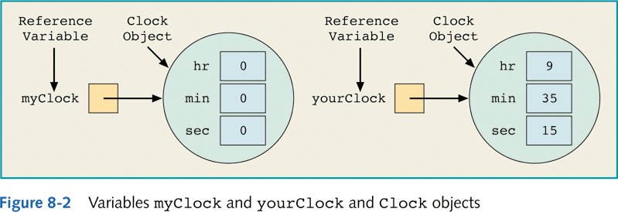
Objects are References in Java
This has important implications!

Slide 22
When comparing two objects, the reference values are being compared and not the object’s values (the dereferenced values).
Comparing Objects for Equality
equal?

Slide 23
The default implementation of the equals method does a shallow comparison of the corresponding data members of each class. The equals method needs to be redefined in the corresponding class in order to perform a deep comparison.
equal?

Slide 24
Assigning Objects

Slide 25
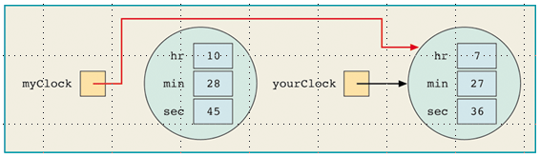
Therefore, assigning one object variable to another does not do what the assignment of primitive types does,
k = 10
n = 10
Assigning one (Clock) object to another,
Variables myClock and yourClock refer to the same object instance!
Variables k and n have distinct values.

Slide 26
class Clock:
Data Members (Instance Variables):
private int hr; //store hours
etc
Methods:
public boolean equals(Clock otherClock)
The equals Method in Java
The equals method is meant to perform a deep comparison. It is a pre-defined method of Java implemented to do a shallow comparison, and therefore must be overwritten (redefined).

Slide 27
public boolean equals(Clock otherClock)
{
if (hr == otherClock.hr && min == otherClock.min &&
sec == otherClock.sec)
return true;
else
return false;
}
The following will always determine if the reference for each of the two objects are equal (i.e., do they both refer to the same object instance?)
clock1 == clock2
The following will perform a deep comparison IF an equals method is defined in the class for properly doing so, otherwise it performs a shallow comparison:
clock1.equals.(clock2)
same as
clock2.equals(clock1)

Slide 28
class Clock:
Data Members (Instance Variables):
private int hr; //store hours
etc
Methods:
public Clock (Clock otherClock)
Copy Constructors in Java
As with the equals method which performs deep comparison of objects, the copy constructor method is meant to perform a deep copy of an object.

Slide 29
// copy constructor
public Clock(Clock otherClock)
{
hr = otherClock.hr;
min = otherClock.min;
sec = otherClock.sec;
}
Java takes this to be a constructor because it has the same name as the class, and has no return type declared. It is a copy constructor since the value that the new object is initialized to is copied from the existing Clock object based to it.
The following creates a new Clock object named clock2 with the same values currently in Clock object clock1.
clock2 = new Clock(clock1)

Slide 30
Special Reference this
Special reference this refers (“points”) to the object instance that a called method is part of.
One use of this is to escape the scope of a method.

Slide 31
public class XYCoord
{
// instance variables
private int x;
private int y;
.
.
public int getX()
{ return x; }
public void setX(int x)
{ x = x ???? }
public int getY()
{ return y; }
public void setY(int y)
{ y = y ???? }
.
.
}
Two instances of “x” and “y”. Want to set instance variable x (and y) to parameter x (and y). Identifiers x and y are ambiguous as written.

Slide 32
public class XYCoord
{
// instance variables
private int x;
private int y;
.
.
public int getX()
{ return x; }
public void setX(int x)
{ this.x = x; }
public int getY()
{ return y; }
public void setY(int y)
{ this.y = y; }
.
.
}
this.x and this.y refer to the instance variables x and y, and x and y refer to the parameter values.

Slide 33
USING OBJECTS IN A PROGRAM

Slide 34
Using Objects in a Program
public class Example
{
public static void main(String[] args)
{
Scanner console = new Scanner(System.in);
XYCoord coord1;
XYCoord coord2;
System.out.print(“Enter first coordinate value as x <space> y: “);
x = console.nextInt(); y = console.nextInt();
coord1 = new XYCoord(x, y);
System.out.print(“Enter second coordinate value: “);
x = console.nextInt(); y = console.nextInt();
coord2 = new XYCoord(x, y);
System.out.println(“Distance between two coordinates is” +
coord1.distance(coord2));
}
}

Slide 35
COMPOSITION IN JAVA
(i.e., objects containing objects)

Slide 36
Using XYCoord Class as a Member of Another Class
Can create a Line class that contains XYCoord objects specifying the endpoints of the line.

Slide 37
public class Line
{
private XYCoord coord1;
private XYCoord coord2;
public Line(XYCoord coord1, XYCoord coord2)
{
this.coord1= coord1;
this.coord2 = coord2;
}
public boolean equals(Line rLine)
// returns true if equal in length
{
return length() == rLine.length();
}
public double length()
{
return coord1.distance(coord2);
}
}
pow is a static method of the Math class

Slide 38
Using Line Objects as Members of Another Class
Can create a Square class that contains Line objects, which in turn contain XYCoord objects.

Slide 39
public class Square
{
private Line[] lines;
public Square(XYCoord upper_left, int length)
// location of upper left corner of square given, along with its size
{
int x = upper_left.getX();
int y = upper_left.getY();
XYCoord upper_right = new XYCoord(x + length, y);
XYCoord lower_right = new XYCoord(x + length, y - length);
XYCoord lower_left = new XYCoord(x , y - length);
lines = new Line[4];
lines[0] = new Line(upper_left, upper_right);
lines[1] = new Line(upper_right, lower_right);
lines[2] = new Line(lower_right, lower_left);
lines[3] = new Line(lower_left, upper_left);
}
public int size() {
return lines[0].length()
}
public int area() {
return (int) Math.pow(lines[0].length(), 2);
}
public boolean equals(Square rSquare) {
return size() == rSquare.size();
}
}
Note that there is the composition of objects two-levels deep (Squares contain Lines, which contain XYCoord objects)

Slide 40
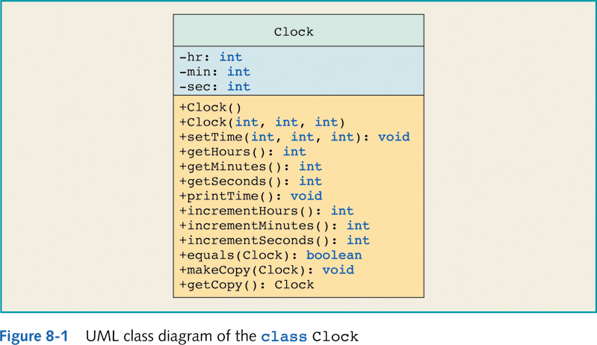
Example UML Class Diagram

Slide 41
Class Scope
With functions (methods), there is the notion of local scope. This means that any variables declared within the function are not accessible by any other function in a program.
There is also the notion of class scope. This means that any method of a class may access all the other members of the class (both instance variables and other methods), whether public or private.
Only members of a class declared public can be access by methods of other classes.

Slide 42
Static Class Members
Members of a class declared static exist even if no object instance of the class have been created.
There exists only one instance of a static member of a class, rather than distinct instances for each object instance created.

Slide 43
public class SpaceShip
{
private int id_num;
private int fuel_level;
private static int num_ships;
public SpaceShip(id, int fuel)
{
id_num = id;
num_ships = num_ships + 1;
}
protected void finalize()
{
num_ships = num_ships - 1;
}
etc.
There is only one instance of variable num_ships because declared static. Static members are accessed through the class name, e.g., SpaceShip.num_ships.
Static variable num_ships incremented every time a new SpaceShip is created.
Static variable num_ships decremented every time a new SpaceShip is destroyed.

Slide 44
public class SpaceShip {
private int id_num;
private int fuel_level;
private static int num_ships;
public SpaceShip(int id, int fuel) {
id_num = id;
fuel_level = fuel;
num_ships = num_ships + 1;
}
public static int getNumShips(){ // static methods can only
return num_ships; // access other static members
// of the class
protected void finalize() {
num_ships = num_ships - 1;
}

Slide 45
Finalizers of a Class
There is an optional finalize method in Java that is executed right before an object is deallocated (deleted).
An object is deallocated when:
It is a local variable of a method, when the method terminates.
There is no variable referencing (“pointing to”) the object, and thus deallocated by the Java garbage collector.

Slide 46
The Use of Finalizers
For most classes, a finalize method is not needed. It is only used then there is something that needs to be “cleaned up” before the object is deallocated.
One example is if an object opens a file when it is created, and the file needs to be properly closed when the object is deleted.
The finalize method is a member of the top-level Object class, and therefore a default implementation is inherited by all classes in Java. Rather than being declared as public or private, it is declared as protected. We will discuss protected members of a class in Chapter 11 on inheritance.

Slide 47
Packages in Java
In most programming languages, there is a way of segmenting a program into namespaces.
To understand the use of namespaces, consider the following example.

Slide 48
Namespaces in Real Life
Suppose the you ran into a friend on campus that was from your home town. In a conversation, the friend might say
“Hey, did you know that John is getting married?”
It turns out that they both have a mutual friend named John, one from their dorm, and the other from their home town. So the other responds with,
“John from the dorm, or from back home?”

Slide 49
Namespaces in Real Life (cont.)
The problem is that the name “John” is ambiguous. The second person is asking is to fully qualify the name,
dorm.John
vs.
home.John
dorm and home can be considered separate namespaces. That is, dorm represents all the names of individuals in the dorm, and home represents all the names from their home town. Therefore, when attaching the name of the namespace to an identifier, the identifier is no longer ambiguous.

Slide 50
Namespaces in Programming
Namespaces are used in programming to distinguish identifiers with the same name that are in different scopes of a program.
Methods have their own scope.
A variable named x in one method (method1) is not the same as a variable named x in another (method2). The are internally distinguished by their fully qualified names:
method1.x method2.x

Slide 51
Namespaces in Programming (cont.)
Classes also have their own scope.
Thus, a method named add in one class is not the same as a variable named add in another. They are also internally distinguished by their fully qualified names:
List.toString() Fraction.toString()
The same is true for the instance (or static) variables of classes.

Slide 52
The Use of Packages in Java
In Java, there is also another level of grouping called packages.
Packages also have their own namespace.
A package is a folder within a hierarchy of folders. Whatever files are within a particular folder are what is contained in the corresponding package.
Every class in Java is in its own file (with some exceptions.) The name of the file must be the same name as the class within it. All the classes in the same folder are therefore in the same package scope.

Slide 53

The Use of Packages in Java (cont.)
This is the folder for the complete program – one of the projects out of all of the current projects that may be identified within NetBeans.
NetBeans automatically creates a folder in the Source Packages folder (src folder) named fractionprogram. This is a package. The name of a package is the same as the name of the folder.

Slide 54
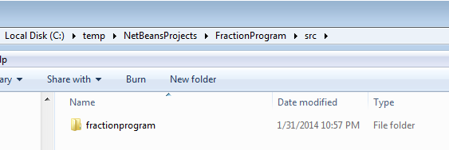
The Use of Packages in Java (cont.)
If you look at the actual folders in Window, you will see the new folder there, within this directory path.

Slide 55
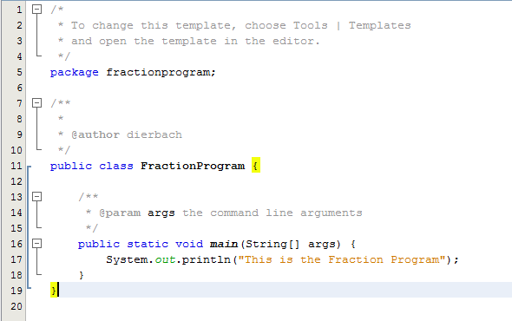
The Use of Packages in Java (cont.)
package statement
Added print statement
We add to the main method a simple print statement. The package statement is automatically added by Netbeans. This indicates where the compiled .class file of this class should be placed.
It is the folder containing the .class files that is the package, not the folder containing the source (.java) files.

Slide 56
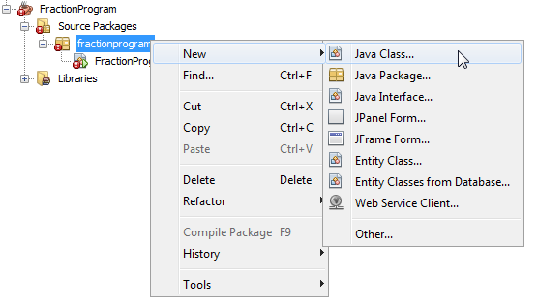
The Use of Packages in Java (cont.)
If you right click on fractionProgram package → New → Java Class, a new Java course file will be created within the package.

Slide 57
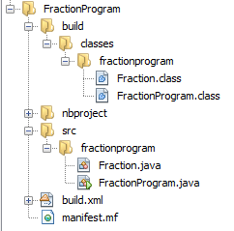
The Use of Packages in Java (cont.)
We add the Fraction class to the project.
This folder contains all of the compiled classes. This folder is a package.
Because each of these files contains a package statement of
package fractionprogram;
the compiled files will be placed in the fractionprogram folder above. Only if a file does not contain a package statement is the .class file placed in the same folder as the .java source file.

Slide 58
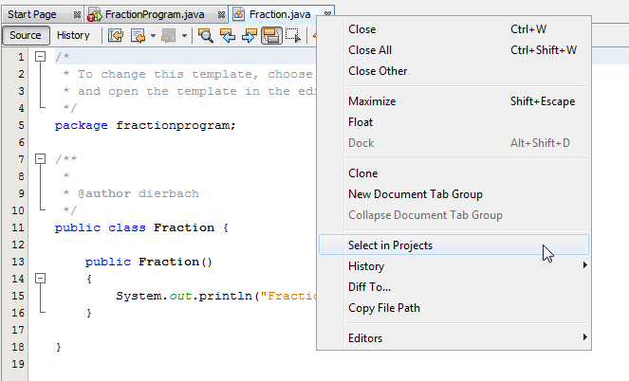
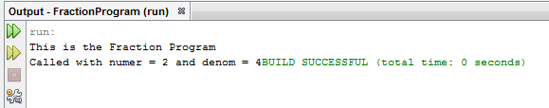
The Use of Packages in Java (cont.)
The Fraction class is found in the fraction program because the FractionProgram class and the Fraction class are in the same package.

Slide 59
The Importing of Packages
Large programs consist of numerous packages. For example, in our Fraction program, the Fraction class might be placed in a different package than the main FractionProgram file.

Slide 60
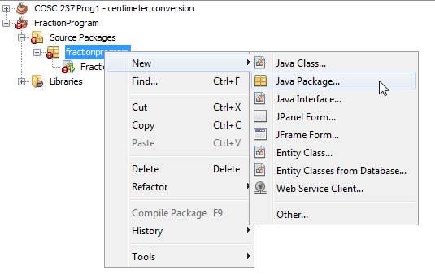
The Importing of Packages (cont.)
To create a new package of the Fraction program, right click on the package name and select New → Java Package.
You will be prompted to enter the new package name.
This will create another folder in the Source Packages (src) folder.

Slide 61
The Importing of Packages
Because of the large number of packages (and classes) in Java, it does not make sense that the namespaces of all packages be part of every program.
Therefore, the import statement is used to indicate to Java which namespaces should be part of any particular Java file.
Note that the import statement does not import any code (classes in Java are dynamically loaded when needed). It only tells Java what (fully-qualified) names to look for.

Slide 62
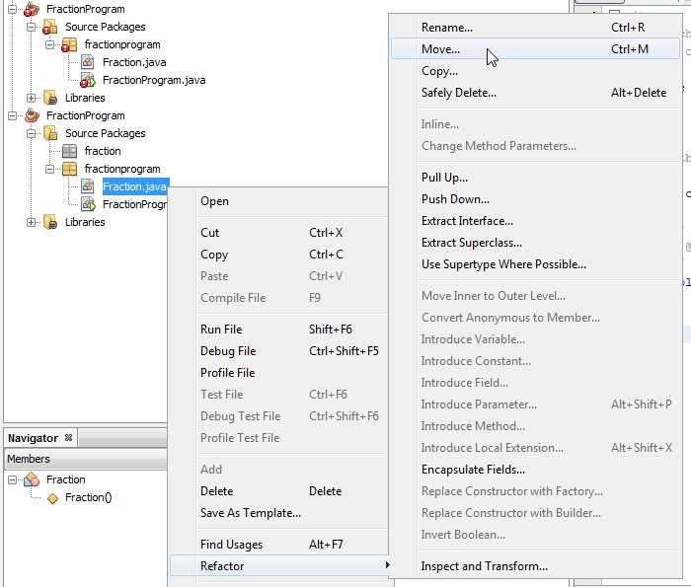
The Importing of Packages
To move a file into another package of the program, right click on the file and select Refactor → Move

